Slide 1

CSCE 240 ChatBot Project
Christian Lee

Slide 2
Scope
My district was District 110, Charleston County
Representative was William Scott Cogswell, Jr.
Programming Language: Java

Slide 3
Data
The data available was from the website about name, region, phone number, etc.
Data that was retrieved was user responses

Slide 4

PA1
Downloaded representative information from text file to array list to sort into variables
Divided up code by different methods such as to read the file, populate array list, get methods

Slide 5
PA2
To check if user query matched data, used if statements, toLowerCase(), equals() and contains() to check if user query matched data
Appended strings together for contact information

Slide 6
PA3
Handled user quitting and unknown questions using while loops and if statements
Used if statements for known user queries

Slide 7
PA4
To check user query matches 70%, separated user input by space delimiter
Used a for loop and a counter to determine 70% threshold
If less than 70%, system printed to reword the question

Slide 8
PA5
Created a new file of data logs using filewriter and bufferedwriter
Used try and catch
Used filewriter to create csv file
File name will not accept “:” so had to change them

Slide 9
PA6
Used David Eta’s code
Basically same as PA5

Slide 10
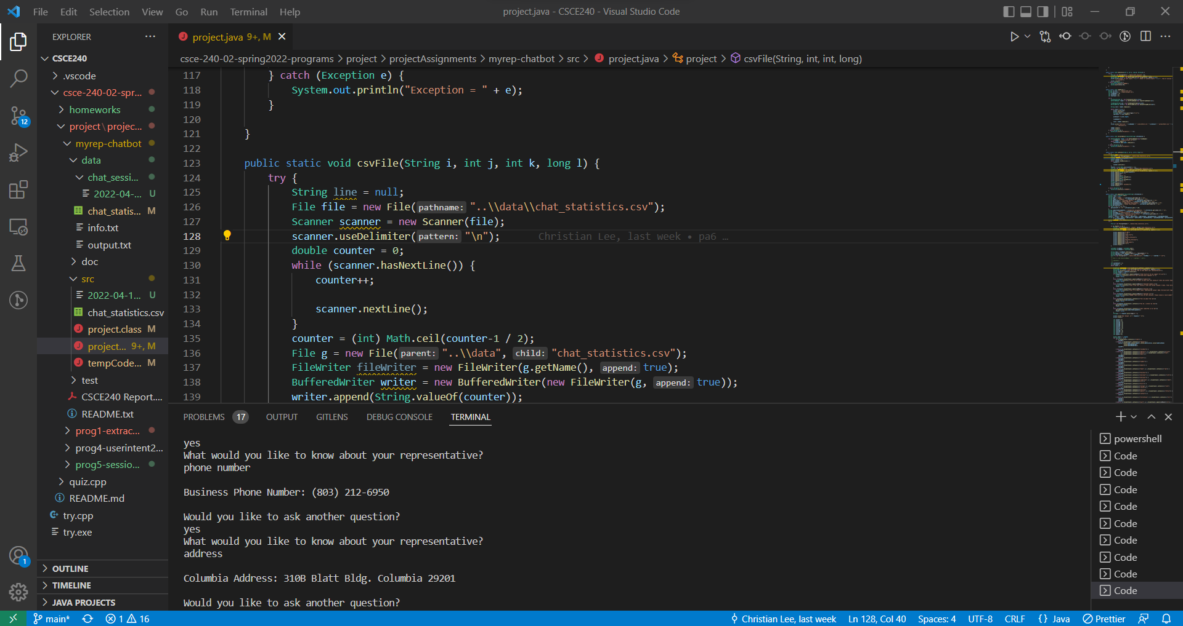
Snapshot
https://www.youtube.com/watch?v=dQsk2IhkTrg

Slide 11
Experience Implementing and Testing
Tested to find errors using system printing
FileWriter and BufferedWriter were sometimes buggy
Tested by quitting immediately to see if it recorded the user input

